Slide 1
Big Data Project - Group 10
Austin Housing Analysis
Ashok Kumar Kolli
Aishwarya Kulkarni
Adhithyan Rangarajan
Keerthana Yelchuri

Slide 2
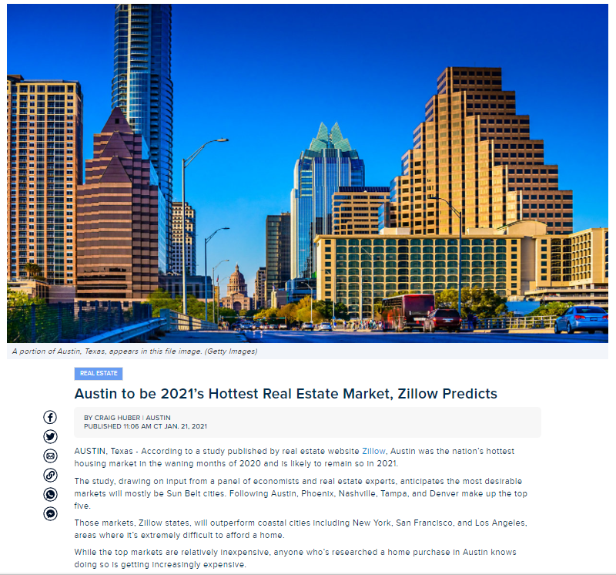
Problem Statement
BUSINESS -
Austin, TX had the highest percentage property price increase last year and is currently the hottest real estate market in the US.
The Austin Board of Realtors recently reported a 26.3% increase in the area’s median home price from October 2019 to October 2020.
The median price for a home in the Austin region is $365,000. A home located within the city of Austin sits at a median $441,250. The top 5 cities with the hottest real estate markets were -Austin, Phoenix,Nashville, Tampa and Denver (in that order)
TECHNICAL-
In the recent years, Machine Learning Algorithms are being widely used to predict house prices in the real estate market.
ML models also offer interesting insights in analyzing various factors and how they contribute to house price fluctuations.
The purpose of this project was to dig deep and develop a good understanding of how to leverage ML models to study price fluctuations due to these factors as an interesting business use case.
https://spectrumlocalnews.com/tx/austin/news/2021/01/21/austin-to-be-2021-s-hottest-real-estate-market--zillow-predicts-

Slide 3
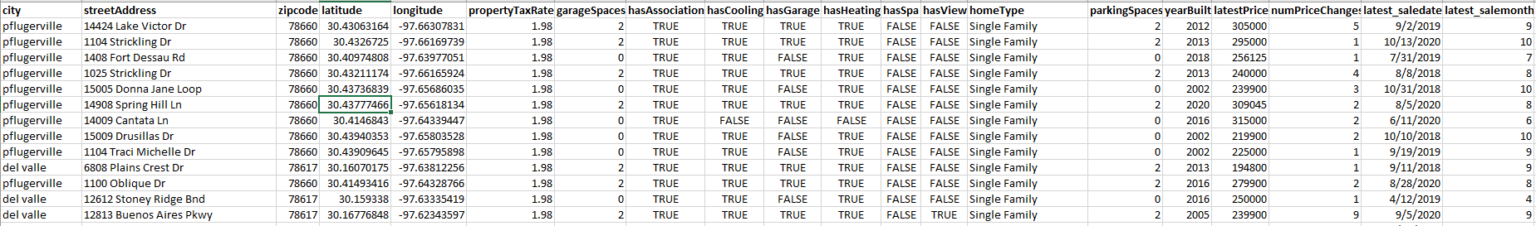
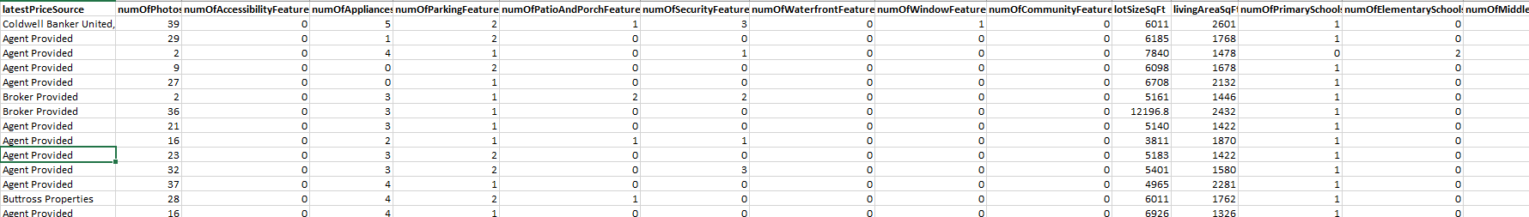
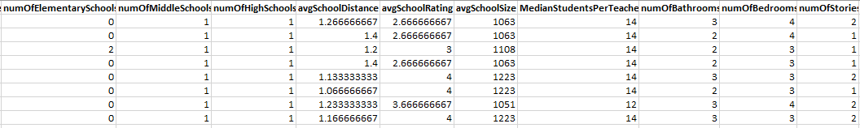
DATASET DESCRIPTION

Slide 4
FEATURES IN THE DATASET
latestPriceSource
numOfPhotos
numOfAccessibilityFeatures
numOfAppliances
numOfParkingFeatures
numOfPatioAndPorchFeatures
numOfSecurityFeatures
numOfWaterfrontFeatures
numOfWindowFeatures
numOfCommunityFeatures
lotSizeSqFt
livingAreaSqFt
numOfPrimarySchools
numOfElementarySchools
numOfMiddleSchools
numOfHighSchools
avgSchoolDistance
avgSchoolRating
avgSchoolSize
MedianStudentsPerTeacher
numOfBathrooms
numOfBedrooms
numOfStories
homeImage
zpid
city
streetAddress
zipcode
latitude
longitude
propertyTaxRate
garageSpaces
hasAssociation
hasCooling
hasGarage
hasHeating
hasSpa
hasView
homeType
parkingSpaces
yearBuilt
latestPrice
numPriceChanges
latest_saledate
latest_salemonth
latest_saleyear
Number of features - 46
Number of features considered for analysis were based on the model.

Slide 5
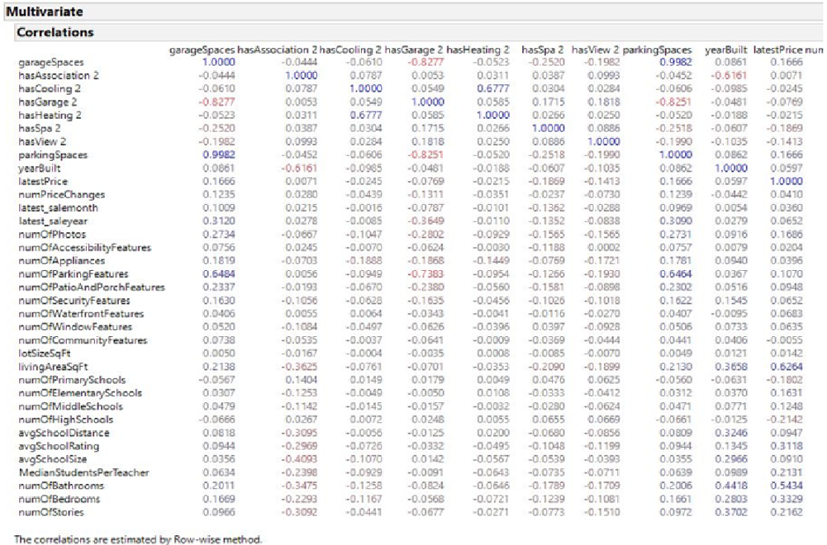
Dataset - Variables and Correlation

Slide 6
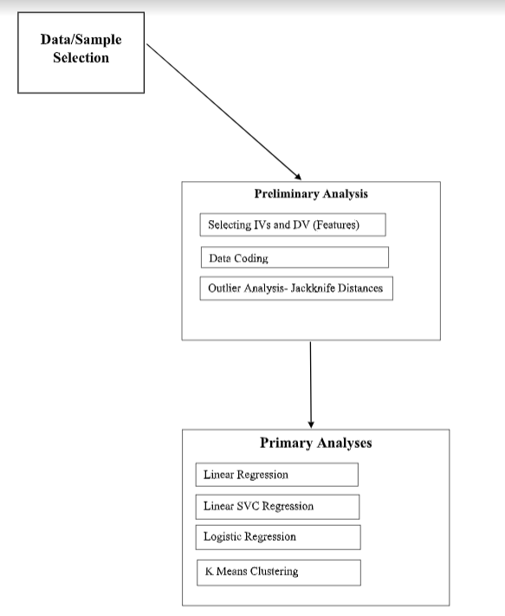
High level flow Chart for the models

Slide 7
Models and their evaluation metrics
Models | Evaluation metrics
Linear Regression | R-squared value: 0.78
Linear SVC | Accuracy : 78.52%
Logistic Regression | Accuracy : 78.74%
K-Means Clustering | Explained using databricks in detail

Slide 8
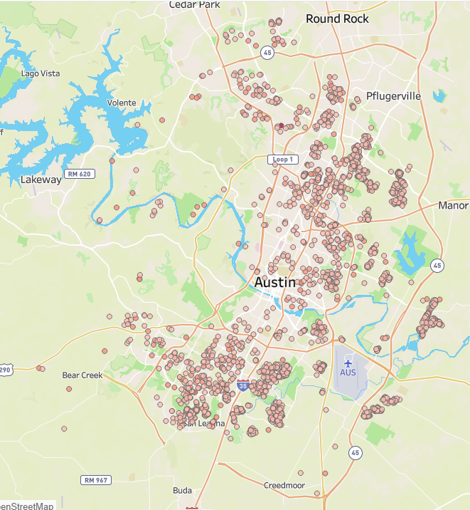
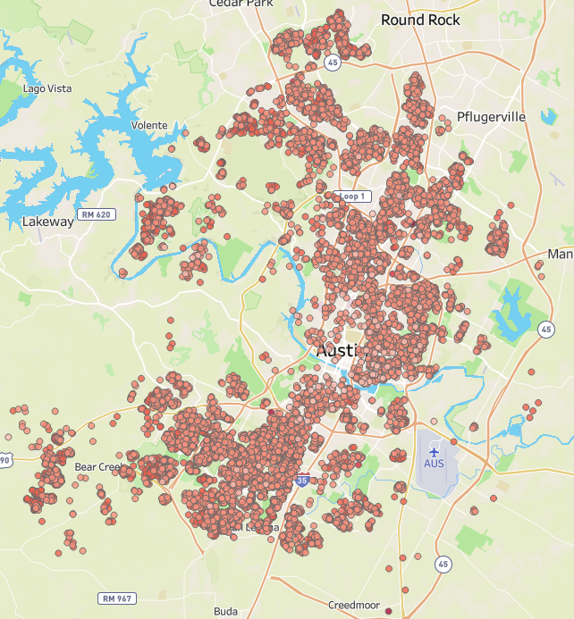
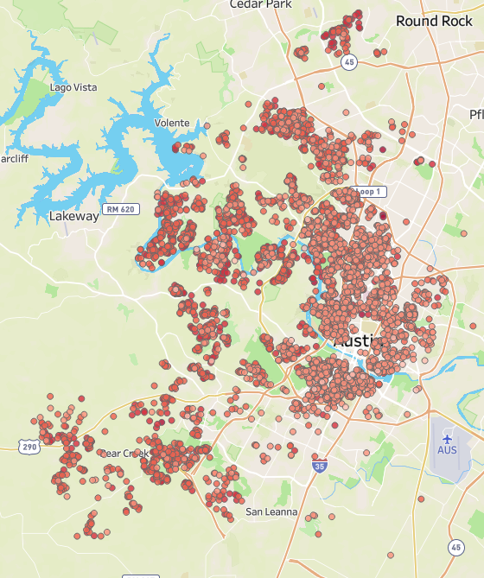
House Prices Distribution on the Map
Below 250K 250K -550K 550K+

Slide 9
REFERENCES
https://www.cnbc.com/2021/01/21/best-real-estate-markets-2021.html
https://www.kaggle.com/ericpierce/austinhousingprices
https://spectrumlocalnews.com/tx/austin/news/2021/01/21/austin-to-be-2021-s-hottest-real-estate-market--zillow-predicts-
https://medium.com/codex/house-price-prediction-with-machine-learning-in-python-cf9df744f7ff

Slide 10
Thank you

